Slide 1
Deanonimization methods in Bitcoin Network
Marko Marić

Slide 2
Index
Brief introduction
Transaction graph analysis
Real-time network analysis

Slide 3
Introduction
Peer-to-peer network
Peers are generating transactions
and broadcast them on network
Miners are peers that are collecting transactions
and trying to generate block
Block = collected transactions + proof-of-work
Miner that first inserts proof-of-work in block
is broadcasting block to network
All peers are adding new blocks on top of
previous ones - building it's own blockchain
Bitcoin network
Block N
Block N-1
…
Block 3
Block 2
Block 1
Blockchain

Slide 4
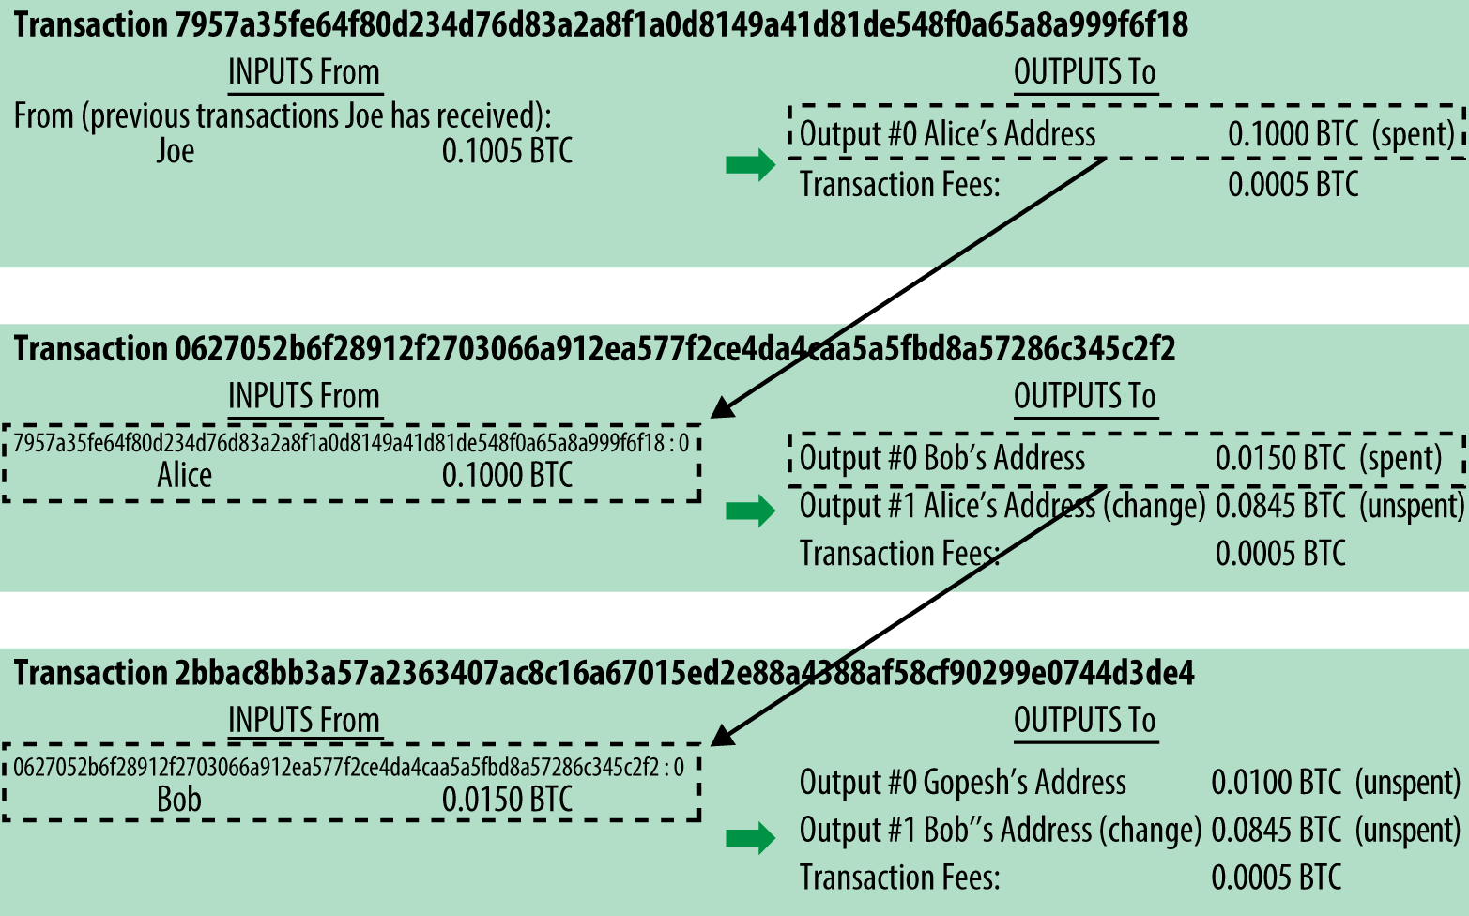
Transaction graph analysis
Blockchain transaction graph
Identity is hidden, but all transactions are public
Main concepts
Input = Output
Change address
Transaction fee

Slide 5
How to deanonimize using blockchain?
Wallets
Containers for private/public keys (not coins!)
Implemented as structured files or simple database
Managed by wallet software
Proof of shared control
Asembling input of transaction from multiple addresses

Slide 6
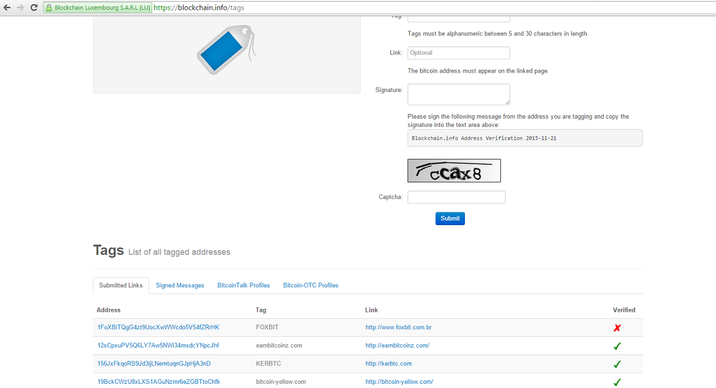
How to deanonimize using blockchain?
„Tagged” users
Web crawling
blockchain.info
bitcointalk.org
Active collecting
Mining pools
Online wallets
Exchanges
Merchants
Gambling

Slide 7
Clustering
Linking different inputs to same user
Transaction inputs with shared address can be link together
2 transactions with inputs (A, B) and (B, C) belongs to user that owns keys A, B, C
Quick expansion of cluster
Tagging clusters
One tagged address in cluster tags all cluster
Combining clusters
Clusters with same tag combined in one cluster

Slide 8
Clustering experiment results
Meiklejohn et al., December 2013
Blockchain parsed and analyzed
16.086.073 transactions, 12.056.684 public keys
5.579.176 clusters of users
5.577.481 combined clusters (20 clusters tagged to Mt.Gox)
Excluded „sink” addresses

Slide 9
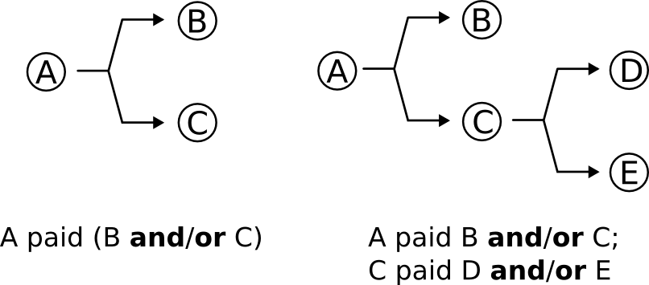
Privacy recommendation
Use new addresses to receive payments
Use multiple wallets for different purposes
Bitcoin address should only be used once
generating new change address
Change returned to sending address ->
Change returned to new address ->

Slide 10
Adding „change address” to inputs
Change address is hard to recognize
Depends on wallet software change-handling methods
Single Address Wallets
Random Address Pool Wallets
Deterministic Address Pool Wallets
User settings
Heuristics
Users rarely issue transactions to two different users -> obsolete
Change address amount is not greater then lowest input amount -> obfuscated?
Change address is used in only one output over all past transactions -> is it safe?

Slide 11
Change address heuristic
Add to input list; address that is used only once in output over all past transactions
Discard coin generation transactions
Discard transactions with self-change address
Discard transactions that have more then one output met CA condition
Experiment results (Meiklejohn et al., December 2013)
4 million change addresses
555.348 false positives (13 percent)

Slide 12
Refining heuristic
12 percent are „payback” addresses
Reducing to 1 percent of false postivies
Waiting to label as change
1 day – false postivies to 0.28%
1 week – false postivies to 0.17%
Further refining (breaking mega cluster)
3.5 million change addresses
3.384.179 clusters
2.197 tagged clusters (1.8 million addresses)
End up with mega cluster containing Mt. Gox, Instawallet, BitPay, Silk Road!
Started with 1.070 tagged addresses

Slide 13
How this can help me?
Direct payments to/from servis
From observed Bitcoin address
To observed Bitcoin address
Indirect payments to/from servis
From observed Bitcoin address over anonymous transactions
To observed Bitcoin address over anonymous transactions

Slide 14
Real time network analysis
Linking Bitcoin addresses to IP addresses
Possible to distinguish different users behind NAT
Linking of different transactions to same user
Even if they look completely unrelated in transaction graph analysis
Problem – using proxies
VPNs, SOCKS proxy, TOR
SOLUTION: Shutdown of Bitcoin over TOR!

Slide 15
„Clients” and „servers”
SERVERS
CLIENTS
Each peer is trying to connect to 8 entry nodes
Network discovery
Servers
Receive incoming connections
Max. 117 incoming connections
Clients
8 outgoing connections
Peers are distinguished
over set of it’s
entry nodes!
8.000
100.000

Slide 16
Disconnecting TOR
Exploiting Bitcoin DOS protection
IP addresses delivering malformed messages are banned for 24 hours
Bann exit node 1
Bann exit node 1
Bann exit node 2
Bann exit node 2
1000 TOR exit nodes
X
8000 Bitcoin servers
-----------------
1GB of traffic
Bann exit node 1
Exit node 1
Bann exit node 2
Exit node 2

Slide 17
Address propagation
Keeps network alive
Nodes come and go
ADDR message
Peer advertises his address in network
After connecting to another node
Every 24 hours
Address propagation
Received address is stored to local database
Propagated to two responsible nodes
Address is not sent over this connections again !

Slide 18
Choosing responsible nodes
For each address X decide individually where to forward:
Calculate hash = H(addr X, salt, current day, &peer struct)
Sort
0x4b227777d4dd1fc61c…
0x4e07408562bedb8b6f…
0x5feceb66ffc86f38d953…
…
…
0xd4735e3a265e16eee0…
0xe7f6c011776e8db7cd2…
0xef2d127de37b942baa5…
These two peers are responsible nodes for address X

Slide 19
Learning entry nodes
ATTACKER
SERVERS
CLIENTS
1
Entry nodes
[2, 3, 4]
2
C
C_{a} entry nodes
[2
,3
,4]
3
4
5

Slide 20
Problem
ATTACKER
SERVERS
CLIENTS
1
Entry nodes
[2, 3, 4]
2
C
C_{a} entry nodes
[1
,3
,4]
3
4
5

Slide 21
Solution
Based on fact that same address is never resent over same connection
History is cleared after 24 hours
Strategy
Periodically on all attacker peers:
1. Broadcast ADDR to deanonymize
2. Establish number of connections

Slide 22
Learning all entry nodes
ATTACKER
SERVERS
CLIENTS
1
Entry nodes
[2, 3, 4]
2
C
C_{a} entry nodes
[2
,3
,4]
3
4
5

Slide 23
Learning part of entry nodes
ATTACKER
SERVERS
CLIENTS
1
Entry nodes
[2, 3, 4]
2
C
C_{a} entry nodes
[3
,4]
3
4
5

Slide 24
Metrics
Peer can be uniquely identified with 3 entry nodes
$\frac{{10}^{5}∗{10}^{5}}{{\left(8∗{10}^{3}\right)}^{3}}≪1$ - Collison is unlikely
35 connections to each server should be enough
$p_{addr}\left(n, N\right)=1−\frac{n}{N}∗\frac{n−1}{N−1}$ ; $p_{addr}\left(90, 125\right)=0.49$
On average 4 ADDR messages will be forwarded to attacker
How often to broadcast address?
$Biryukov, Khovratovich, Pustogarov, July 2014$
Experiment: „10 minutes seems to be reasonable choice”

Slide 25
What do we have?
What we have?
ADDR(C_{a}) = (3,5,11,13,17)
ADDR(C_{b}) = (5,7,13,9,2)
ADDR(C_{c}) = (1,7,4,5)
How to deanonymize transaction?
Client and attacker are connected with one hop over entry node
All other connections between them are 2 hops or more
Attacker will see transaction coming from entry nodes before then from any others.

Slide 26
Transaction propagation
Client –> entry node -> attacker
(2 x INVENTORY, 2 x GETDATA, 1 x TRANSACTION)
5 messages, 16 checks, random trickling delay
Client –> entry node -> peer A -> attacker
(3 x INVENTORY, 3 x GETDATA, 2 x TRANSACTION)
8 messages, 32 checks, 2 random trickeling delays

Slide 27
How to deanonimize transaction?
First 15 transactions
Receiving transaction from different peers
Peers(Trans1): [ ,19…]
Checking transaction against different EN sets
ADDR(C_{a}) ∩ Peers(Trans1) =
ADDR(C_{b}) ∩ Peers(Trans1) =
ADDR(C_{c}) ∩ Peers(Trans1) =
Entry nodes (EN) sets:
ADDR(C_{a}) = (3,5,11,13,17)
ADDR(C_{b}) = (5,7,13,9,2)
ADDR(C_{c}) = (1,7,4,5)
3,5,10,8,1,2,12,17,6,14,11,9,7,4,13
(3,5,17,11,13)
(5,2,9,7,13)
It is ambiguous if C_{a} or C_{b} or C_{c} generated transaction
(5,1,7,4)

Slide 28
How to deanonimize transaction?
First 6 transactions
Receiving transaction from different peers
Peers(Trans1): [ ,12,17,6,14,11,9,7,4,13 ,19…]
Checking transaction against different EN sets
ADDR(C_{a}) ∩ Peers(Trans1) =
ADDR(C_{b}) ∩ Peers(Trans1) =
ADDR(C_{c}) ∩ Peers(Trans1) =
Entry nodes (EN) sets:
ADDR(C_{a}) = (3,5,11,13,17)
ADDR(C_{b}) = (5,7,13,9,2)
ADDR(C_{c}) = (1,7,4,5)
3,5,10,8,1,2
(3,5)
Not enough to distinguish client (3 nodes needed)!
(5,2)
(5,1)
𝐵𝑖𝑟𝑦𝑢𝑘𝑜𝑣, 𝐾ℎ𝑜𝑣𝑟𝑎𝑡𝑜𝑣𝑖𝑐ℎ, 𝑃𝑢𝑠𝑡𝑜𝑔𝑎𝑟𝑜𝑣, 𝐽𝑢𝑙𝑦 2014: best balance is q=10

Slide 29
How to deanonimize transaction?
First 10 transactions
Receiving transaction from different peers
Peers(Trans1): [ , ,11,9,7,4,13 ,19…]
Checking transaction against different EN sets
ADDR(C_{a}) ∩ Peers(Trans1) =
ADDR(C_{b}) ∩ Peers(Trans1) =
ADDR(C_{c}) ∩ Peers(Trans1) =
Entry nodes (EN) sets:
ADDR(C_{a}) = (3,5,11,13,17)
ADDR(C_{b}) = (5,7,13,9,2)
ADDR(C_{c}) = (1,7,4,5)
3,5,10,8,1,2,12,17,6,14
(3,5, 17)
(5,2)
Node Ca generated transaction
(5,1)

Slide 30
Experiment results (𝐵𝑖𝑟𝑦𝑢𝑘𝑜𝑣, 𝐾ℎ𝑜𝑣𝑟𝑎𝑡𝑜𝑣𝑖𝑐ℎ, 𝑃𝑢𝑠𝑡𝑜𝑔𝑎𝑟𝑜𝑣, 𝐽𝑢𝑙𝑦 2014)
Bitcoin testnet
250 bitcoin servers
Custom attacker client
Bitcoin Core (Clients)
Metrics
Propagation of ADDR messages each 10 minutes
Count for only first 10 nodes to forward transaction
3 entry nodes for identification
Result
59.9% of transactions was successfully deanonymized

Slide 31
Conclusions
On real Bitcoin network - estimations
If attacker maintains 50 connections to servers
Successful deanonymization
$$p_{ADDR}^{AVG}=0.34$$
$$P_{success}^{ }(3)=0.11$$

Slide 32
How this can help me?
Direct deanonymization
Indirect deanonymization
Deanonymization of Bitcoin address that made/receive payment to/from target
Combining with transaction graph analysis
Linkage of Bitcoin addresses that are unrealted in transaction graph

Slide 33
Final words..
Network RT analysis requires IP address beforehand
Estimated success rate is very poor
Ethics

